Slide 1
FOOD ORDER PLATFORM

Slide 2
Agenda
Introduction
Data Pre-Processing
Recommendation
Conclusion
EDA & Insghits
Data Overview

Slide 3
Introduction
The dataset contains information collected from an online food ordering platform over a period of time.

Slide 4
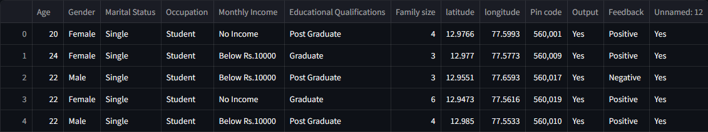
Data Overview
First 5 Rows Of Dataset

Slide 5
Pre-Processing
Drop Unnaned:12 col.
Check Null values.
Remove Duplicates.
Check Outliers.
Get Country col.
Get City col.

Slide 6
EDA & Insights

Slide 7
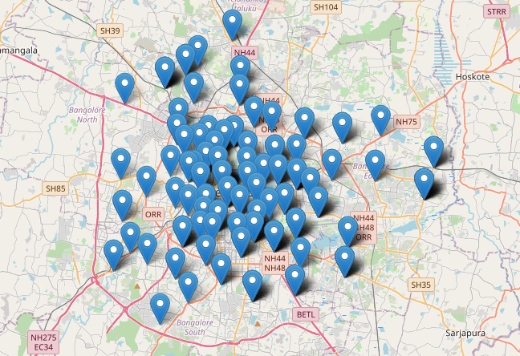
As we see, the target of this platform is india , specific Bengaluru.

Slide 8
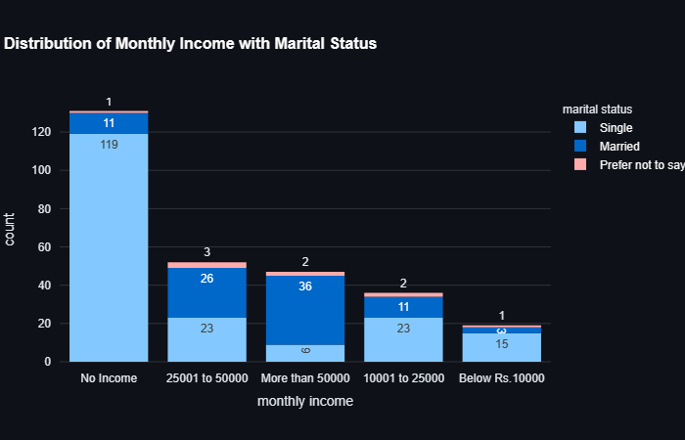
Income & Marital Status
As we see, - Most of people has more than 50000 are married. -And most of people has no income are single.

Slide 9
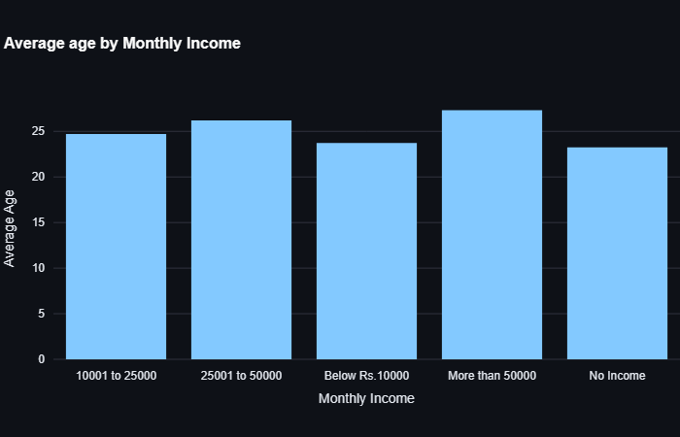
Avg age & Income
- Avg ages 23 has no income. - Avg ages 24 has income 10,001 : 25,000. - Avg ages 26 has income 25,000 : 50,000. - Avg ages 27 has income more than 50,000.

Slide 10
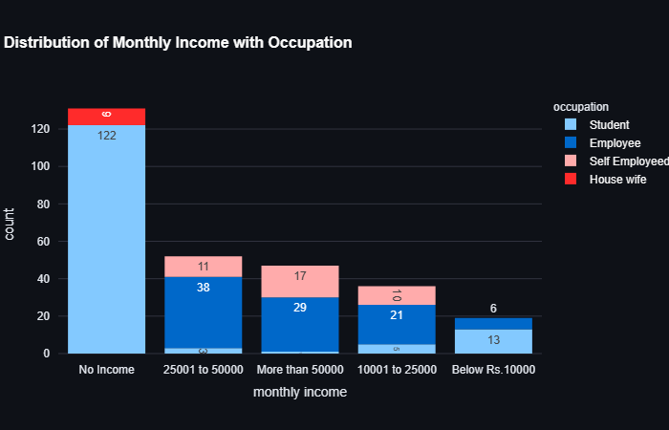
Occupation & Income
- Most of people has no income are students. - People with income more than 50000 are employee or self employed.

Slide 11
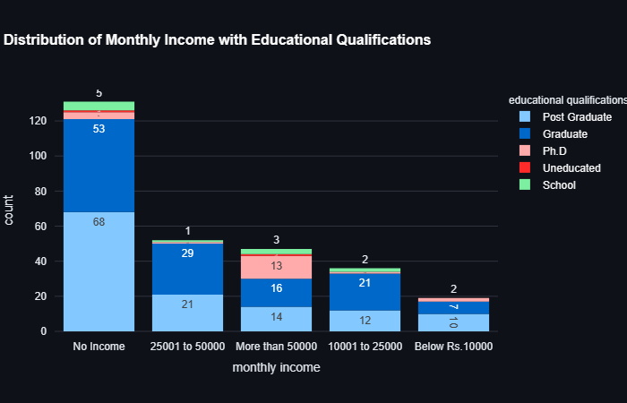
Education & Income
- Most of Graduates and Post Graduates have no income or 25000 : 50000.

Slide 12
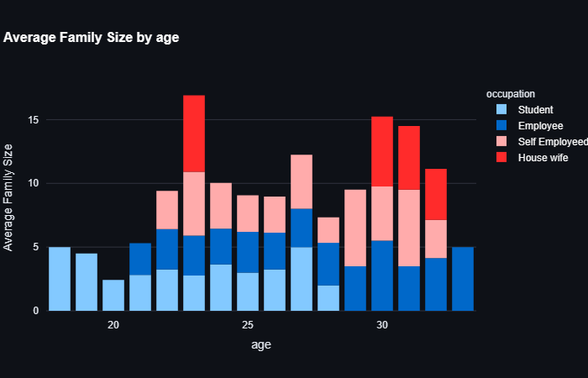
Avg Family size & Age
- House wife with age 23 has the highest avg family size which is 6. - students and self employed with age 28 have lowest avg family size which is 2.

Slide 13
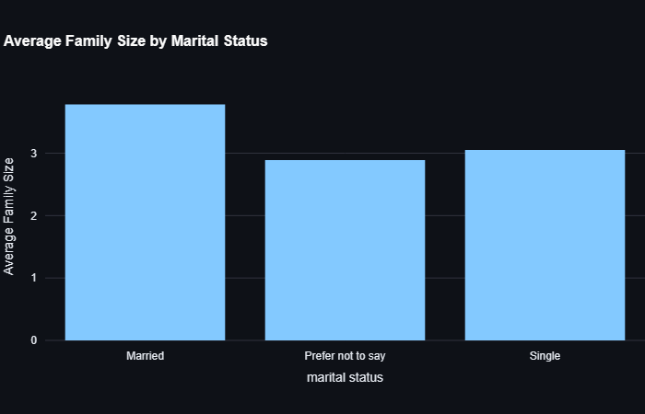
Avg Family size & Marital Status
- Married has avg family size 4. - Single has avg family size 3.

Slide 14
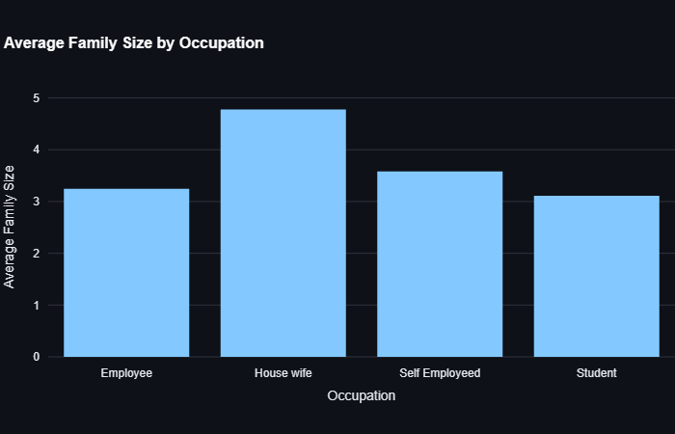
Avg Family size & Occupation
- House wife has the largest avg family size as 4.8 - Students have the least avg family size.

Slide 15
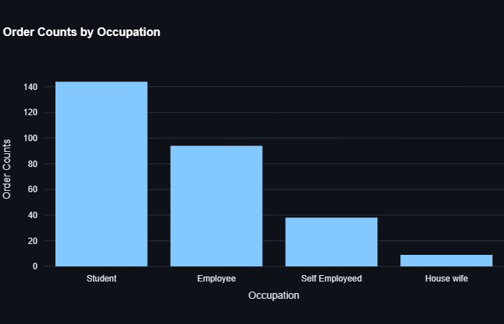
Order Counts by Occupation
- Most of orders made by students. - Least of orders made by house wife.

Slide 16
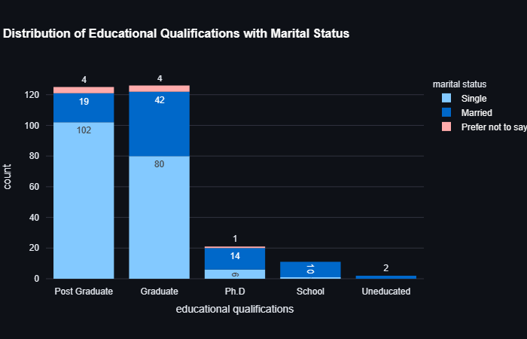
Education & Marital Status
- Most of singles are post graduated people. - Most of married are graduated people. - Most of Ph.D people are married. - school and uneducated are married.

Slide 17
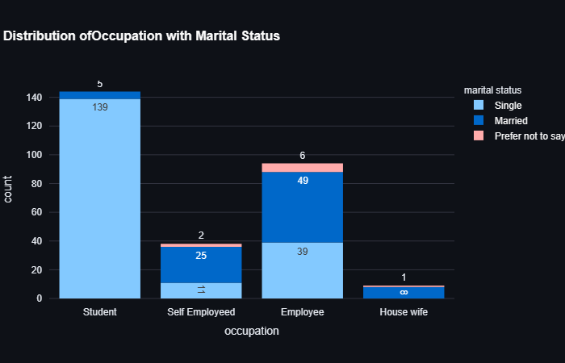
Occupation & Marital Status
- Most of Students are single. -Most Of employee and house wife are married.

Slide 18
Recommendations
Spreadout across india and other countries.
Be aware of prices and service as most of them are students and employees.
Make Special offers.

Slide 19
Conclusion
Most of users are single , students and have no income
House wife have highest avg family size

Slide 20
Conclusion
Most of Graduates and Post Graduates are single, so more orders.
House wife is the least for making orders.

Slide 21
Thanks!

